Slide 1

Computer Engineering Department A.P. Shah Institute of Technology G.B.Road, Kasarvadavli, Thane(W), Mumbai-400615 UNIVERSITY OF MUMBAI Academic Year 2022-2023

Slide 2
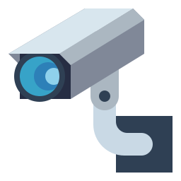

THIRD EYE
Under the Guidance of Prof. Selvin Furtado

Slide 3





OUR TEAM(Div-A)
Priyanshu Agarkar
Pranav Chopdekar
Sahil Gujar
Komal Chitnis
Roll no-1
Roll no-27
Roll no- 54
Roll no-26

Slide 4


Problem Statement
With recent advances in AI capabilities, it is possible than ever to implement surveillance systems that can automatically detect people who might represent a potential security threat to the public in real-time.
Crime rate around the world has been increasing since the last 3-4 years.
Necessity of detecting suspicious activity arises with the intention of reducing the overall crime rate all around the world thus leading to a peaceful life.
THIRD EYE

Slide 5

Objectives
Creation of user friendly GUI interface.
Using various image recognition and video processing algorithms for identifying the feed.
Processing of the action and predicting whether the action done was suspicious or not.
THIRD EYE

Slide 6

Scope
Object detection and tracking: The camera would use computer vision algorithms (MobileNet-SSD v3 ) to detect and track objects, in this case, people in real-time.
AI-based activity detection: The fixed camera would use OpenVINO to specify the restricted area for Suspicious Activity Detection.
Event detection and Setting Alarm: The camera would be able to detect events, such as an movement of a person , and set Alarm to notify the Admin.
THIRD EYE

Slide 7
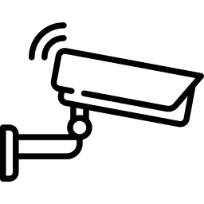

Technology Stack
Computer Vision Libraries:Opencv could be used for object detection, tracking and activity recognition.
AI Frameworks: OpenCV(ROI) could be used for defining Area which is not accessible to others.
Frontend Development: A web interface will be developed to showcase the video interface.
Backend Development: The backend system could be developed using a server-side programming language such as Python for accessing the captured data.
THIRD EYE

Slide 8
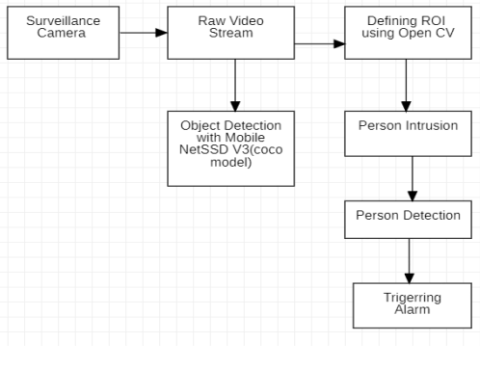
Architecture Diagram
THIRD EYE

Slide 9
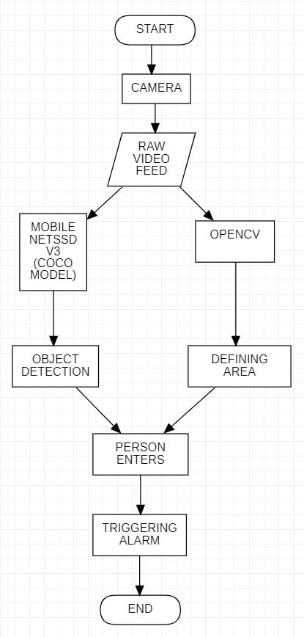
Flowchart
THIRD EYE

Slide 10
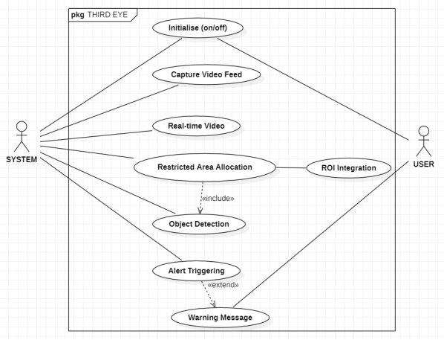
Use Case Diagram
THIRD EYE

Slide 11
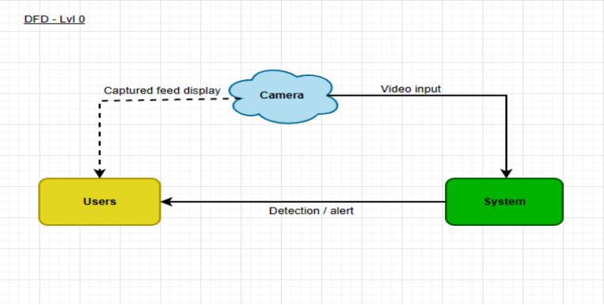
DFD: Level-0
THIRD EYE

Slide 12
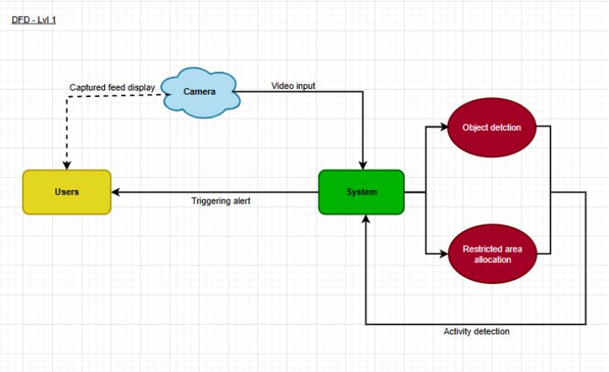
DFD: Level-1
THIRD EYE

Slide 13
List of Modules
Creation of Object Detection Program.
Creating Simple Frontend.
Detecting Suspicious Activity.
Setting Up Alarm.
THIRD EYE

Slide 14
Module 1: Creation of Object Detection Program
For our project to perceive the presence of various objects, we used MobileNet-SSD v3 model.
It is a model which uses COCO dataset for training.
The COCO dataset consists of 80 classes of images so the objects detected would belong from one of these classes only.
Using MobileNet-SSD v3 along with OpenCV, the objects in the frame are detected through real time external camera feed.
THIRD EYE

Slide 15
Module 2: Creating Simple Frontend
To represent the real time camera feed, a simple frontend is designed consisting of the frame(screen) itself along with a toggle button.
This feed would be used to represent the object detection model made using MobilenetSSD using the COCO dataset.
The toggle button integration would be done for future use.
THIRD EYE

Slide 16
Module 3: Detecting Suspicious Activity
An activity would be called suspicious if and only if a person enters the restricted area.
The restricted area in this case can be defined real time with the help of ROI.
If a person try’s to invade the restricted area in absence of the owner, the activity would be termed as Suspicious.
THIRD EYE

Slide 17
Module 4: Setting Up Alarm
One’s the suspicious activity is detected, an Alarm would get triggered.
The Alarm will be used to let the user/Admin know that a suspicious activity is being detected.
For now, the Alarm would be set in the system itself.
THIRD EYE

Slide 18
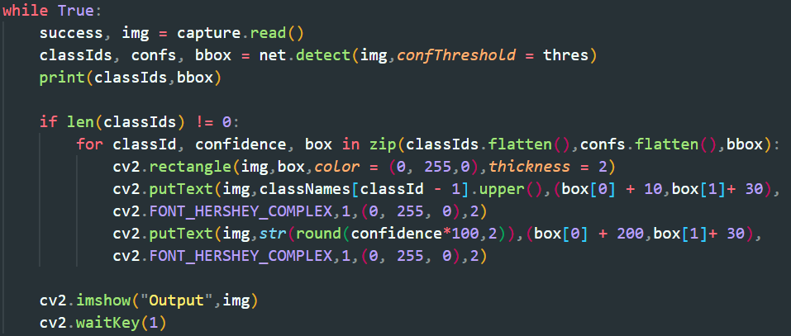
Implementation(Code Snippet for Object Detection)
THIRD EYE

Slide 19
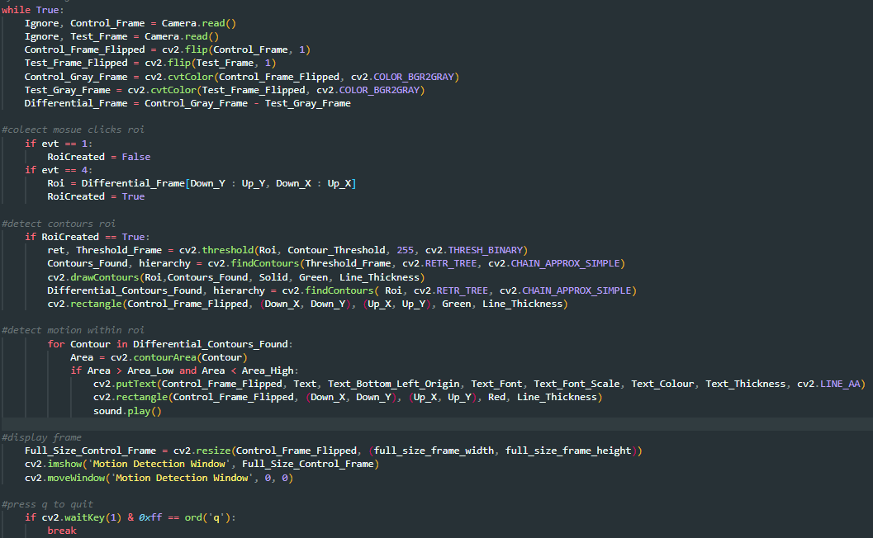
Implementation(Code snippet of ROI)
THIRD EYE

Slide 20
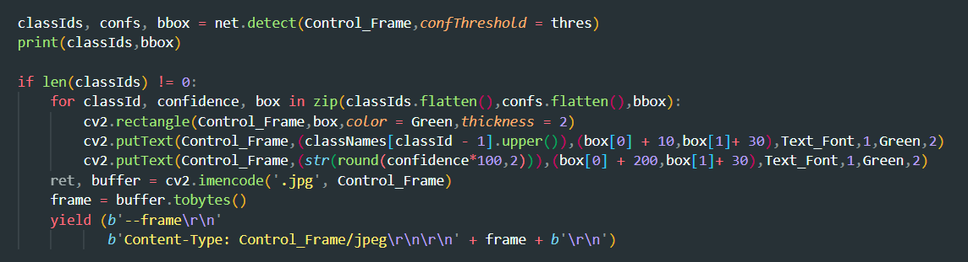
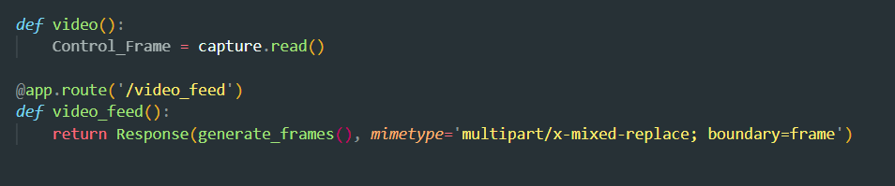
Implementation(Code snippet of Flask)
THIRD EYE

Slide 21
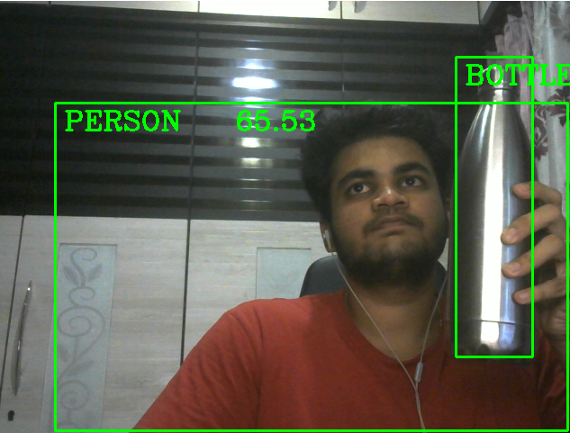
Object detection program implementation screenshot
THIRD EYE

Slide 22
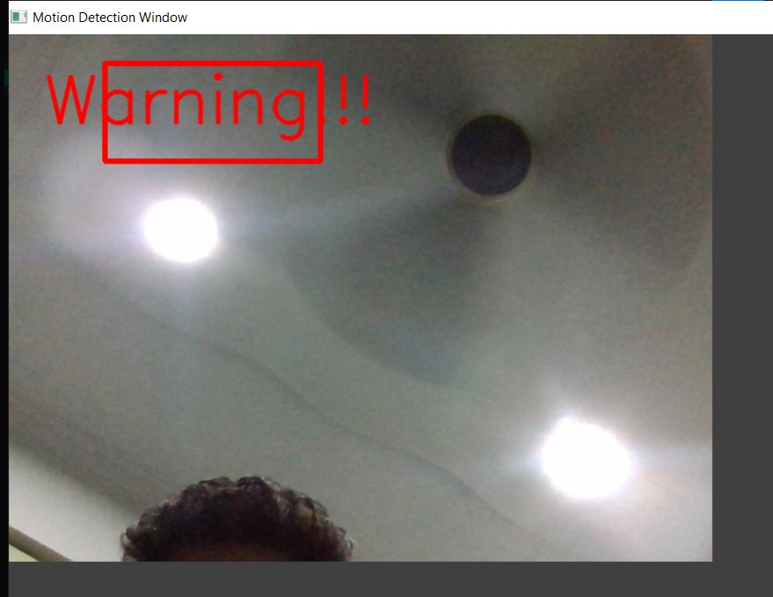
ROI program implementation screenshot
THIRD EYE

Slide 23
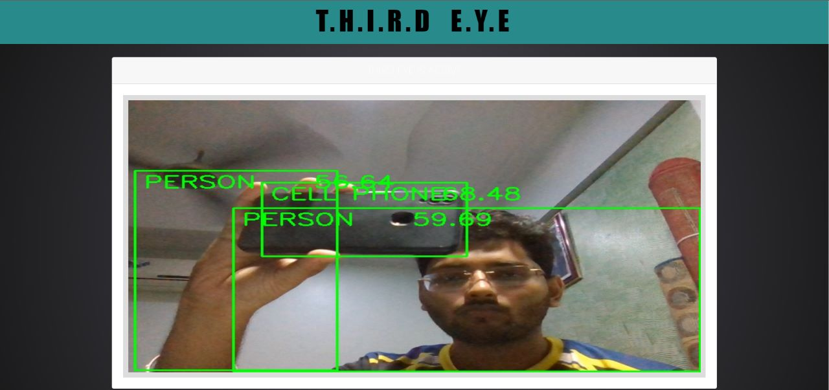
Frontend screenshot
THIRD EYE

Slide 24
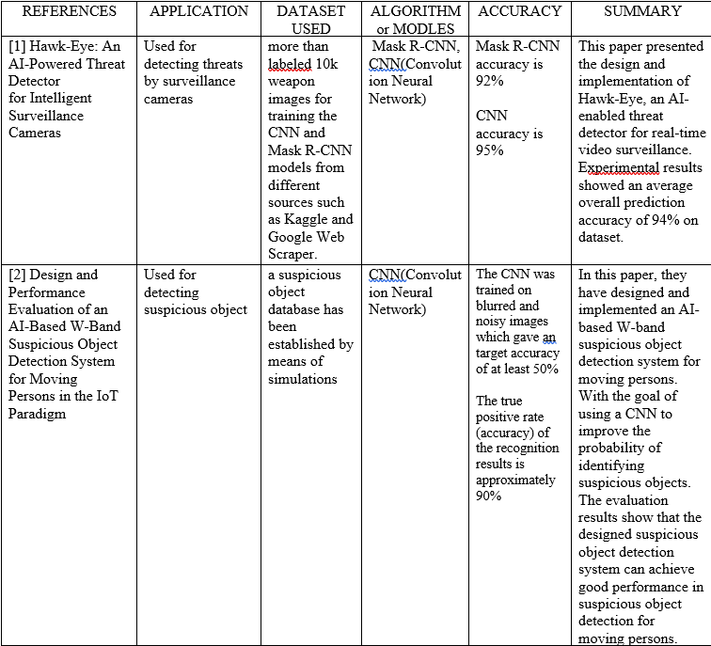
References 1
THIRD EYE

Slide 25
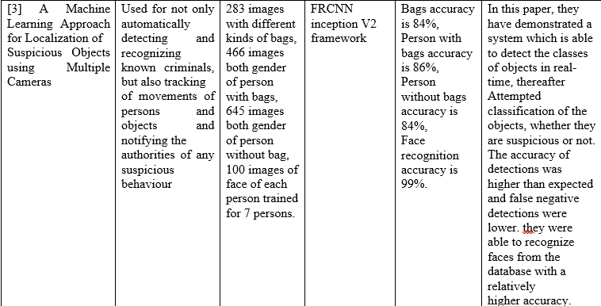
References 2
THIRD EYE

Slide 26
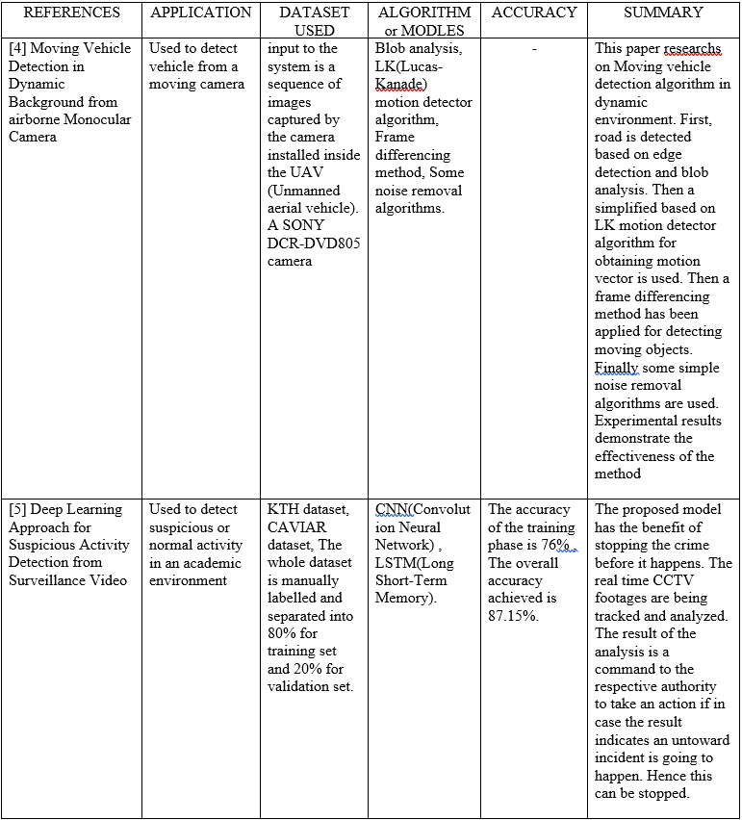
References 3
THIRD EYE

